Slide 1


Shubham Patil’s Report
pizza Hut

Slide 2


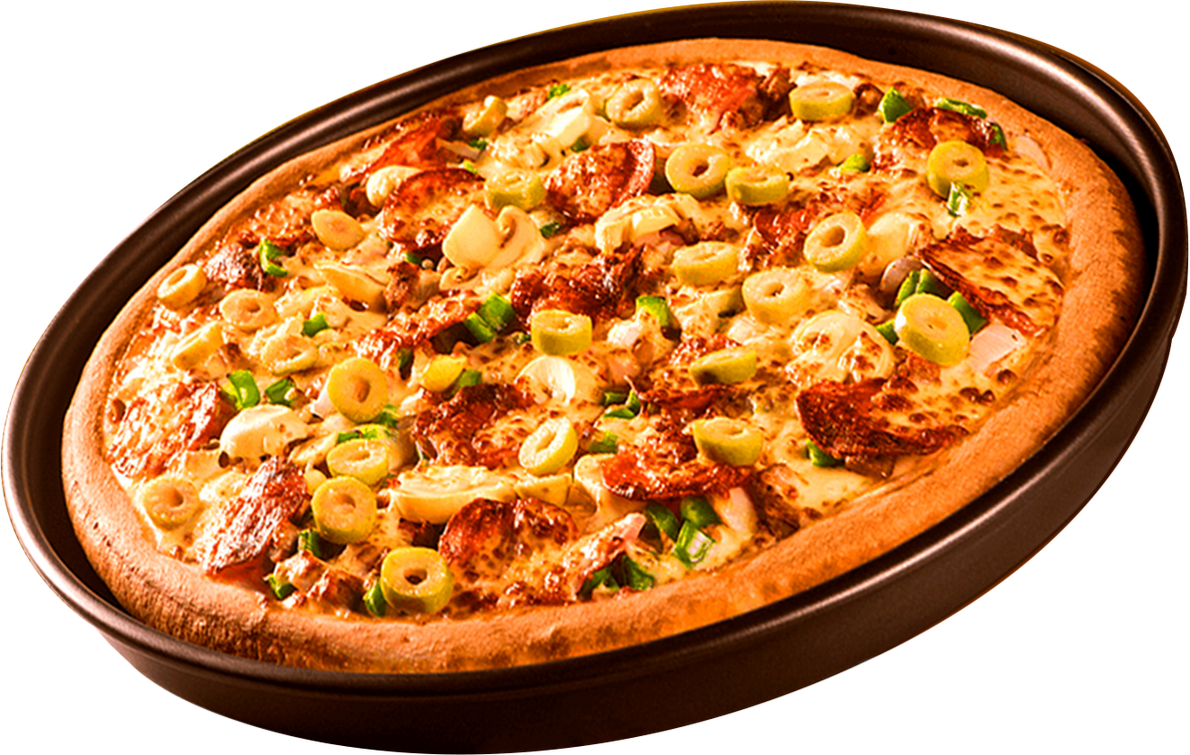

SQL Based Project
welcome to
pizza hut’s Report Card
In this SQL based project we are going to solve different questions from basic to advanced level which will enhance our knowledge about the Pizza Hut.

Slide 3

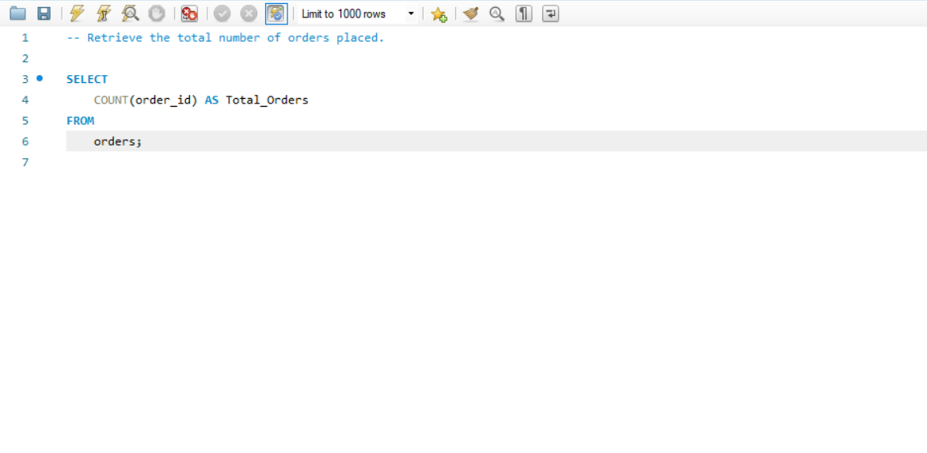

Type - Basic
Q1. Retrieve the total number of orders placed.

Slide 4
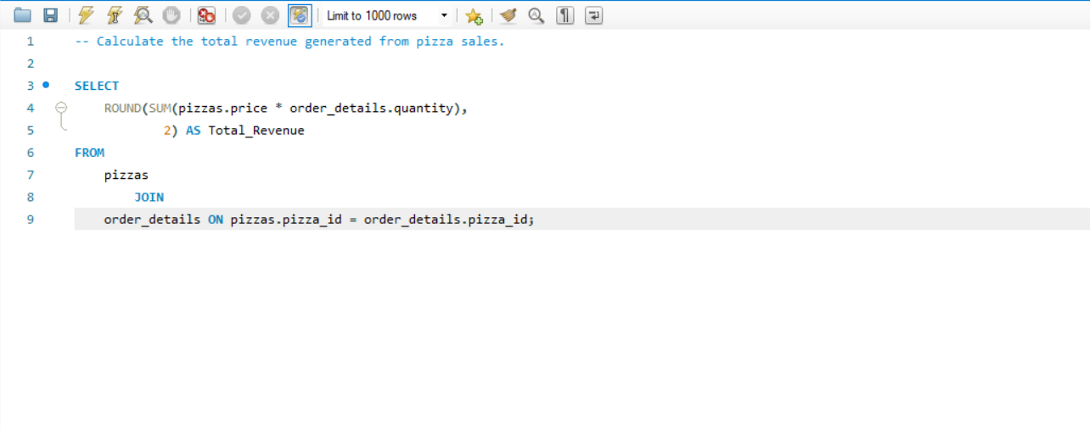
Type - Basic
Q2. Calculate the total revenue generated from pizza sales.
.

Slide 5
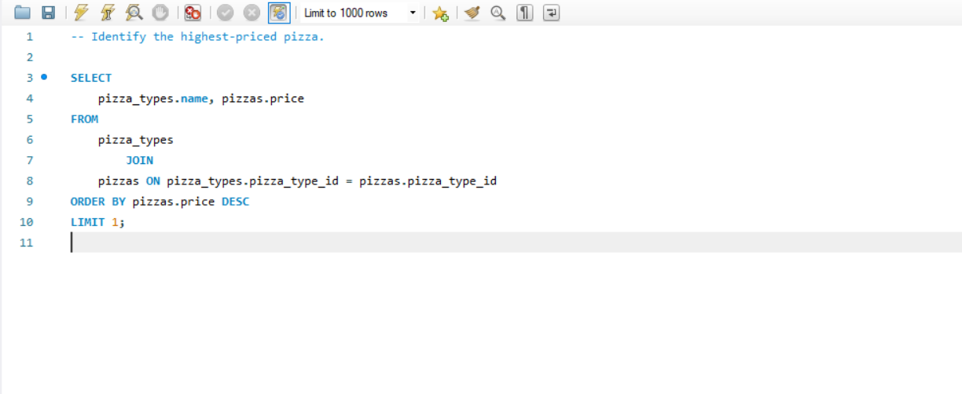
Type - Basic
Q3. Identify the highest-priced pizza.

Slide 6
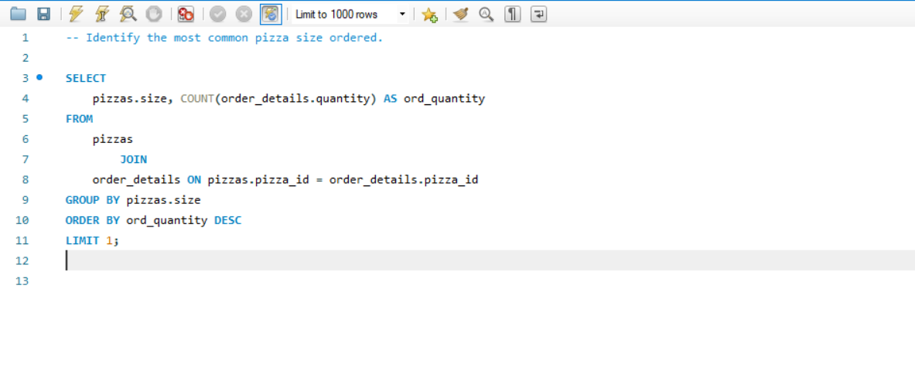
Type - Basic
Q4. Identify the most common pizza size ordered..

Slide 7
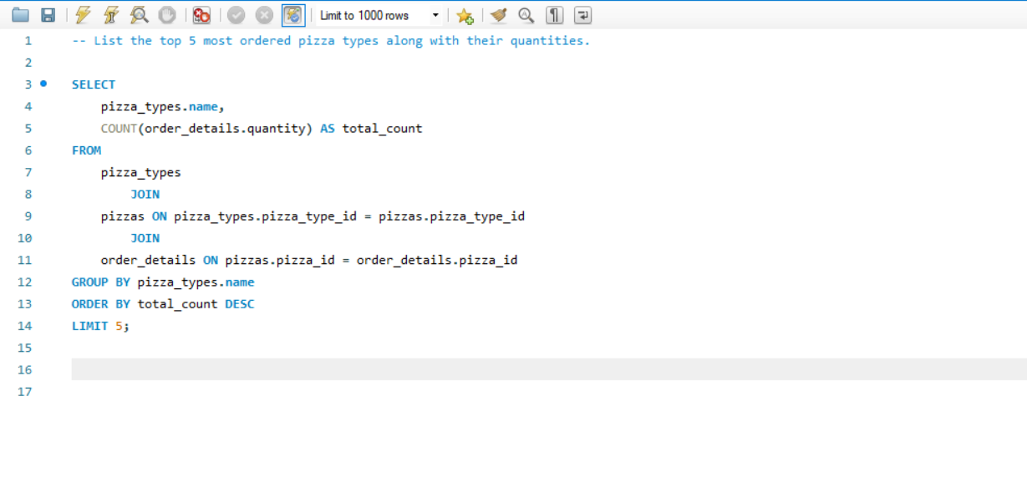
Type - Basic
Q5. List the top 5 most ordered pizza types along with their quantities.

Slide 8
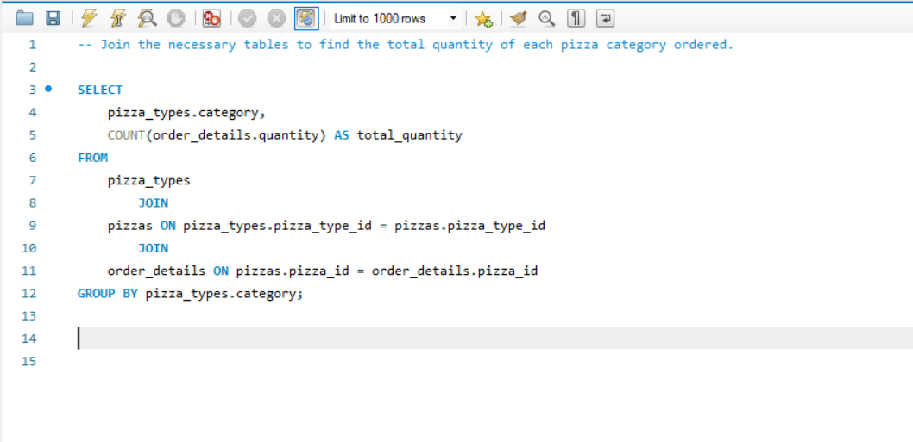
Type - Intermediate
Q1. Join the necessary tables to find the total quantity of each pizza category ordered.

Slide 9
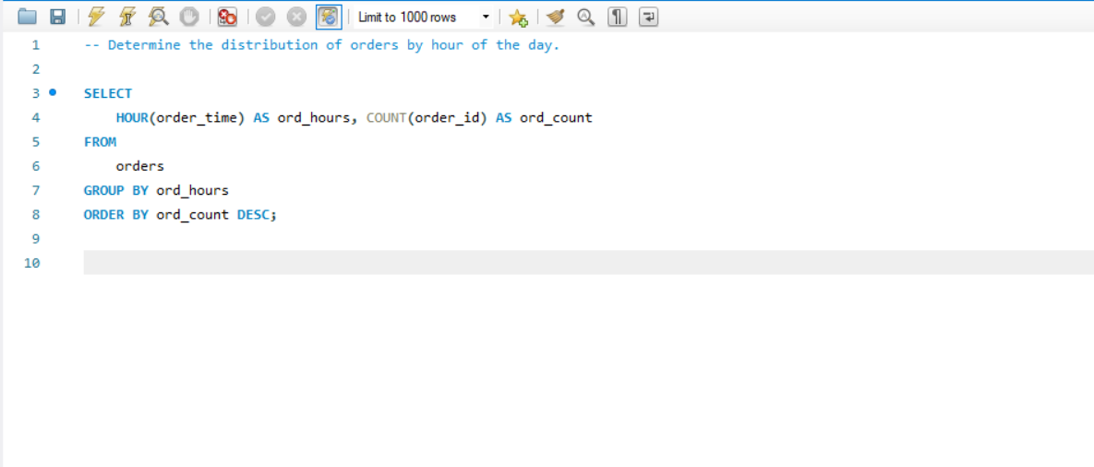
Type - Intermediate
Q2. Determine the distribution of orders by hour of the day.

Slide 10
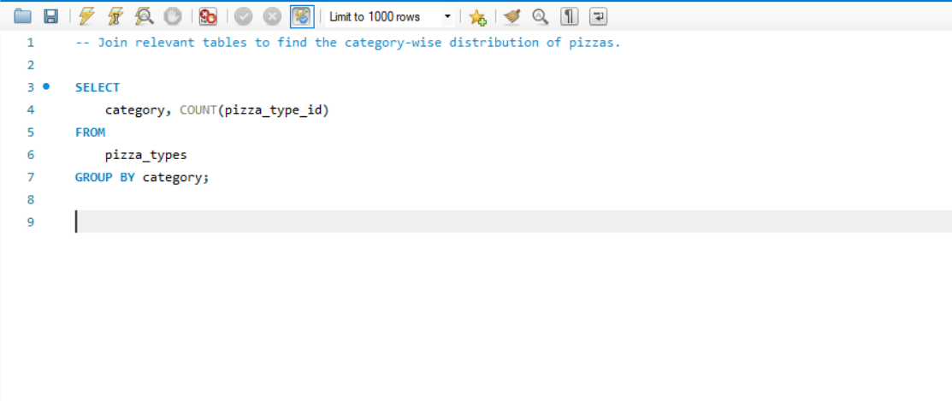
Type - Intermediate
Q3. Join relevant tables to find the category-wise distribution of pizzas.

Slide 11
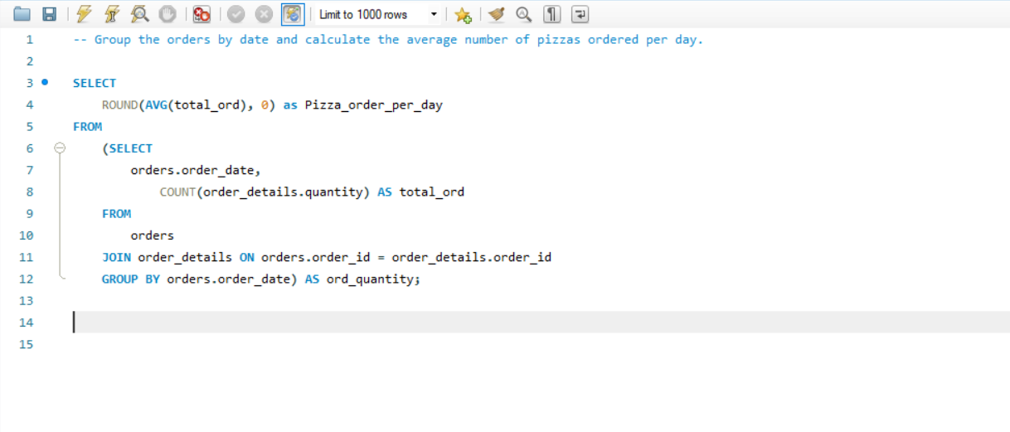
Type - Intermediate
Q4. Group the orders by date and calculate the average number of pizzas ordered per day.

Slide 12
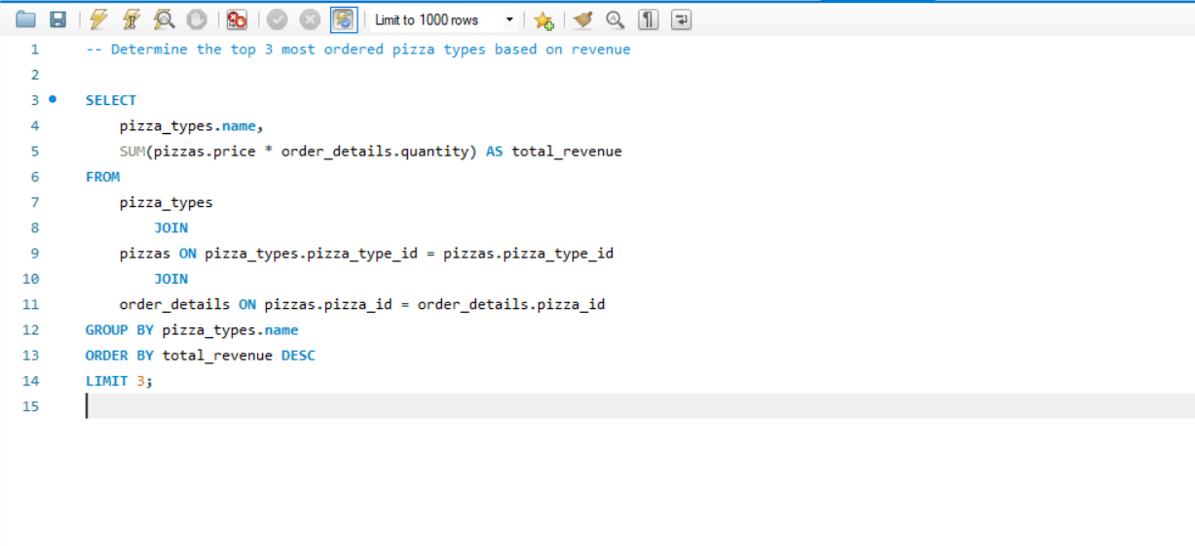
Type - Intermediate
Q5. Determine the top 3 most ordered pizza types based on revenue.

Slide 13
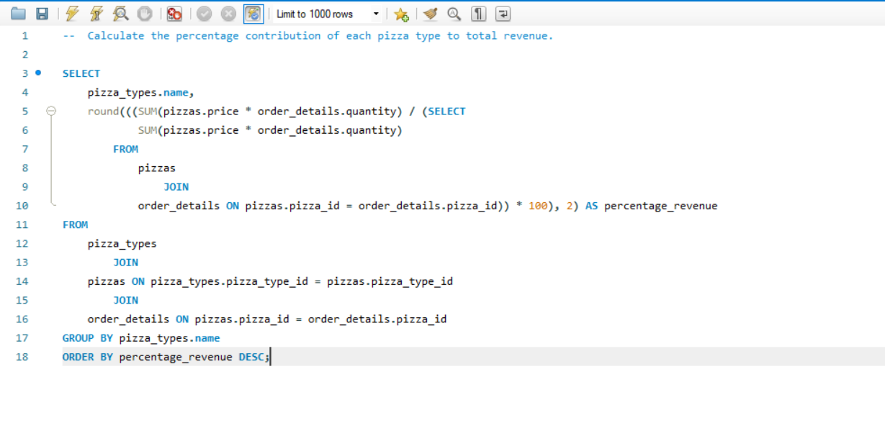
Type - Advanced
Q1. Calculate the percentage contribution of each pizza type to total revenue.

Slide 14
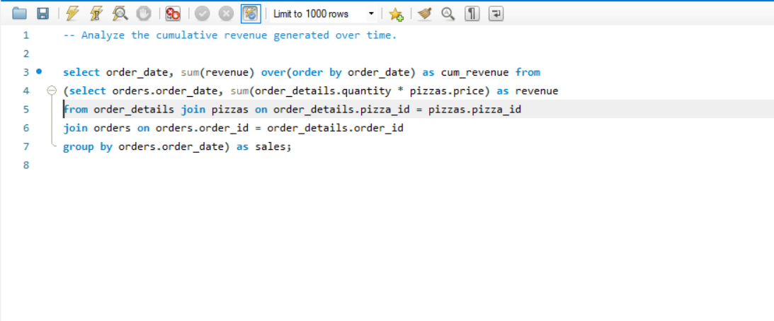
Type - Advanced
Q2. Analyze the cumulative revenue generated over time.

Slide 15
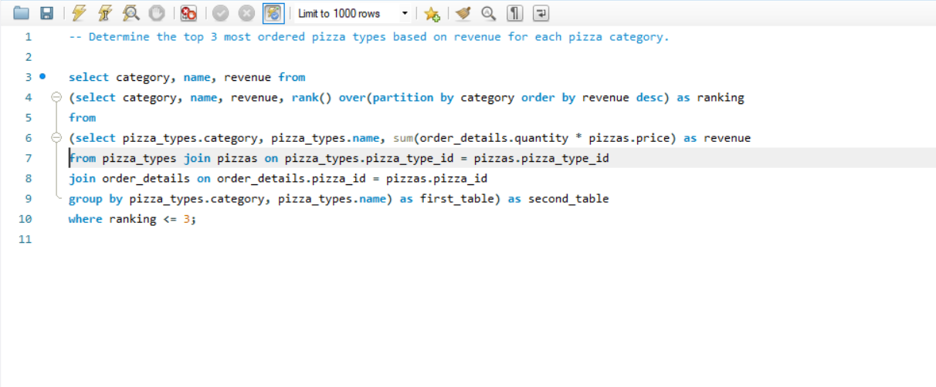
Type - Advanced
Q3. Determine the top 3 most ordered pizza types based on revenue for each pizza category.

Slide 16

Thank You

